Slide 1

Competition in the new digital era Adapting to the growth of the Fintech
A Brainstorming session by sandy Aggarwal
(Director/SVP – Technology & Architecture @ Mizuho Americas)
Dec 4th, 2020
This Photo by Unknown Author is licensed under CC BY

Slide 2
Competition in the new digital era: Adapting to the growth of the Fintech
Presentation Topics
Fintech’s delivering a paradigm shift, and how incumbents must remain agile to remain competitive
Investing in Fintech and integrating them into your EA
Third Parties and their impact on EA
Shaping understanding of customer data to improve product development
What to expect in this short session?
This presentation is being offered as an information sharing session
We’ll review how and when Fintech started and where it stands now
You’ll have a renewed appreciation for how the latest developments in the Fintech space are putting a competitive pressure on the conventional Financial Institutions
You’ll gain an understanding of how Fintech innovation is leading to an explosion in Fintech IPOs and what that means for different players in the game
Finally, we’ll touch upon possible areas of cooperation between the incumbents and the challengers

Slide 3
How do banks compete?
Michael Porter’s 3 basic strategies for competition:
The fundamental basis of above average profitability in the long run is sustainable competitive advantage, which can be achieved using these three basic strategies:
Cost Leadership
Banking is a low margin business in general – most income comes in from premium service charges and interest differential. Over the last many decades, banks have been competing at cost level, vying to pick up customers by offering the same service at a lower cost.
FinTech can help companies drive down costs or get in the game with very little upfront costs (i.e. break the entry barrier).
Differentiation
The question here is, given the same financial products and cost, why should a customer come to you? What’s the difference between you and the shop next door? The answer normally is quality of customer service and bank’s reputation.
Fintech banking has allowed companies to focus on specialized products and services. For instance, Robinhood focuses on (free) investment banking Robinhood as a differentiator against traditional players like Fidelity and TD Ameritrade.
Focus
Overall, banks can be categorized into buckets such as commercial banks, loans & savings banks, credit unions, insurance companies and so forth. Also, banks operate at international, national, regional and local levels, Furthermore. they focus on specific segments of customers, catering to specific needs. Mizuho and MUFG, for instance, primarily focus on Japanese corporate customers.
On the Fintech side, companies focusing on specific markets include Paytm which operates mainly in the Indian sub-continent and M-PESA which operates mainly in the African continent.
Typical funding minimum required for setting up a bank is around $10 MM USD. On the contrary, a Fintech based bank can be started in much lesser.
According to Citizen, “A2A payments via Open Banking can have significantly lower per-transaction costs than card payments; ours are below 1%. This is because A2A payments completely bypass card infrastructure, and the costs associated with this. Fees for card and wallet-based payments typically reach 3% of a transaction.”
Financial Institutions range from bulge bracket firms such as Goldman Sachs to credit unions such as DCU. With the deluge of new Fintechs, these definitions are fast merging. Number of physical branches a bank has, is no more an indicator of their success.
According to Crunchbase, “Traditionally, financial services did all of their competing and bundling based on the location of the bank branch. However, Fintechs are not restrained by geography.”

Slide 4

What is FinTech?
The term FinTech, or “Financial Technology”, is a term that became mainstream just after Y2K, but the origins of Fintech go all the way back to 1860s when the first transatlantic cable was laid down and more recently Fintech has evolved into an assimilation of AI, RPA, Blockchains & DAPPS and everything in between.
Early History (Fintech 1.0)
1860: The Pan-telegraph was invented (NT Times)
1880: Use of charge plates and charge coins for credit
Mid History (Fintech 2.0)
1918 – 1970 – The invention of Fedwire
The Economic Consequences of the Peace – first book linking Finance & Technology by Maynard Keynes
Modern History & New Developments (Fintech 3.0 and 3.5)
Diners club (1950) & American Express (1958) introduce their credit cards
1960: Ticker tape by Quotron to display stock prices
1971: Nasdaq is established; 1973 SWIFT is launched and remains at the core of the banking industry
1980s: Evolution of e-trade and online banking
2009: Release of Bitcoin, Square is founded
2011: Google Wallet
2015: Release of Ethereum & Hyperledger as programmable digital ledgers
2017: “Smile to Pay” by Alibaba
2018: ICE (NYSE Parent Company) launches Bakkt for digital custody (first company to make Bitcoin Futures official).
2019: Facebook announces Libra initiative. PSD2 Open Banking initiative comes into force.
2020: Multiple Fintech startups take center stage, Plaid was acquired by Visa for $5.3B on Jan 13, 2020. PayPal announces support for cryptocurrencies.
Quick Bytes
Brief History of FinTech - CNBC
https://www.youtube.com/watch?v=-EoNrg_DR3s
The FinTech Revolution - by Gregory La Blanc, Berkeley Haas https://www.youtube.com/watch?v=EC1V9MvzX4Q

Slide 5
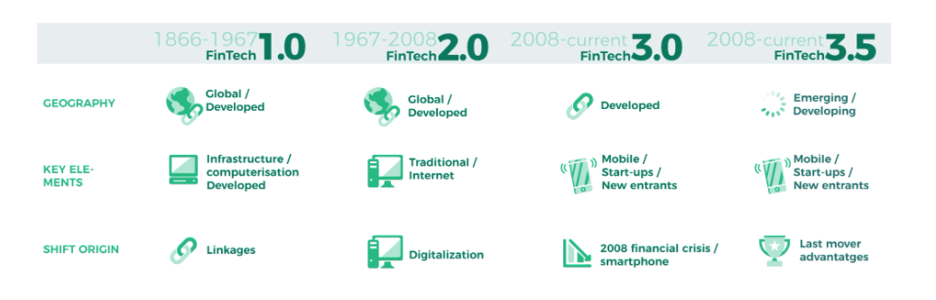
A Timeline of key fintech milestones
1800s
FinTech 1.0
1900s
FinTech 2.0
2000s
FinTech 3.0 → 3.5

Slide 6
Fintech’s delivering a Paradigm shift
Change in Customers’ Expectations
With a hyper focus on customers’ personal needs, Fintechs are delivering an experience equivalent to social apps. With Venmo allowing the millennials to share tabs in a bar or grocery bills at their dorms (and with emojis ☺), no one is dying to get cash from the ATMs.
There are multiple neo-banks (such as N26, Monzo and Revolut) which allow customers to sign up online and open a bank account in a matter of minutes as against days. In the US, Goldman Sachs’ Marcus has come up as an online bank, but most other traditional banks do not have similar offers yet.
Traditional banks have long relied on “Same-Old” methods such as that of account verification. Fintechs like Bakkt, N26 and Marcus allow you to open new bank accounts online and in minutes.
Social Acceptance of Digital Cash
Adoption rate of FinTech is much higher in developing markets compared to developed markets due to two main factors: (a) There is an urgent need to provide banking options to the unbanked. (b) Cell phones are almost ubiquitous, and the users are willing to try on new ways to bank.
The pandemic of 2020 has only accelerated the Fintech adoption as going to the physical branches was not a preferred option (or not an optional at all).
Change in Federal Mindset
Federal authorities are realizing the need for accepting concepts such as #OpenBanking.
Europe made PSD2 official in January 2018.
Canada just announced restart of discussions along this line last week.
The US has not joined this party yet, primarily due to a slew of regulatory constraints.
China is purportedly really close to announcing their CBDC (Central Bank Digital Currency).
Libra (Lite) may live to see daylight and come to be accepted by the US regulators within a few weeks from now.

Slide 7
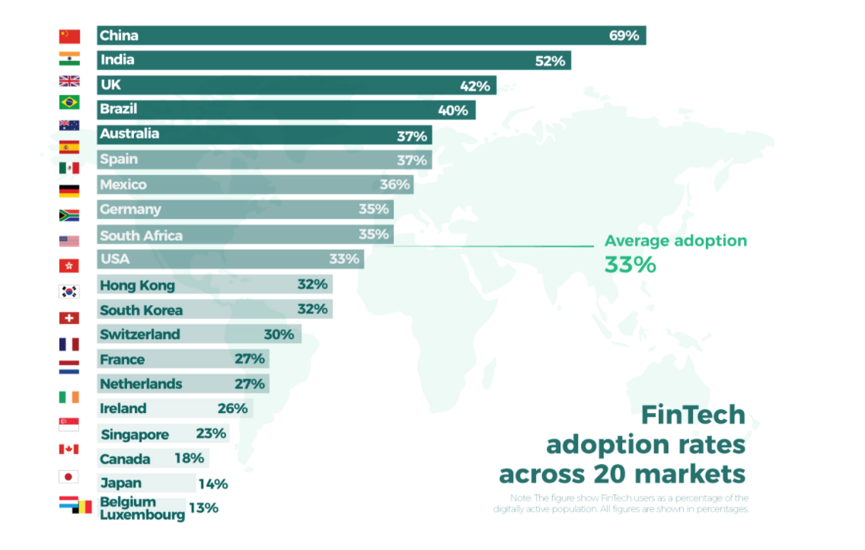
Fintech adoption
China and India are the top Fintech markets with adoption rates of 69% and 52% resp.
FinTech 3.5 is taking place much more rapidly in developing markets with a higher number of “unbanked”, which leads to much higher adoption
M-Pesa in Kenya and CashFree & PayTM in India are prime examples of P2P payments.
On the other hand, companies like Adyen, Plaid, Stripe, Square and PayPal are changing the way businesses collect and process payments
Source: https://www.e-zigurat.com/innovation-school/blog/evolution-of-fintech/

Slide 8
Fintech integration into enterprise architecture
Critical Assessment: Is your company future-ready?
First thing first: Critically assess your products and services and devise an EA overhaul plan. This roadmap to digital transformation from McKinsey is still valid today. Also, consider this Open Banking platform strategy by MuleSoft.
Understand difference between digitization and digitalization
Is your company still dependent on huge monolithic apps, many of which are vendor supported? How long does it take for your core systems to be upgraded or replaced?
Does your EA team have the right set of PPT (People, Process & Technology) to help you compete?
Do you have an official Fintech strategy and a top-down charter? You cannot make EA level changes merely by wishful thinking. This will need budgeting.
Plan your approach for Fintech Adoption
Greenfield EA (Building a new product or launching a new Fintech platform)
Brownfield EA (Re-architecting legacy platforms to enable Fintech integration)
Enabling your systems to be Fintech ready
Enable use of micro-services (aka SOA in its prior life)
Use of Cloud compatible/native architecture is not a must have but it surely helps.
Embark on a process to automate operational processes using RPA
Using a buy vs build assessment, make use of 3rd party products to expedite implementation of new functions
Embed APIs from Fintech vendors (such as Plaid, Stripe, Square and PayPal). Railsbank is part of the growing fintech trend of B2B firms offering ‘embedded finance’ to financial and non-financial firms alike.
Use of 3rd party providers which provide Baas (Banking as a Service) to allow non-banks to embed banking services within their apps.
Invest in other Fintechs (Prime example: Western Union. WU was almost made obsolete by Fintechs like Xoom, Remitly, M-Pesa etc.)
However, don’t lose focus on cyber-security and strong third-party risk management controls in a race to deliver fast. Bad rep is like black death in digital world.

Slide 9
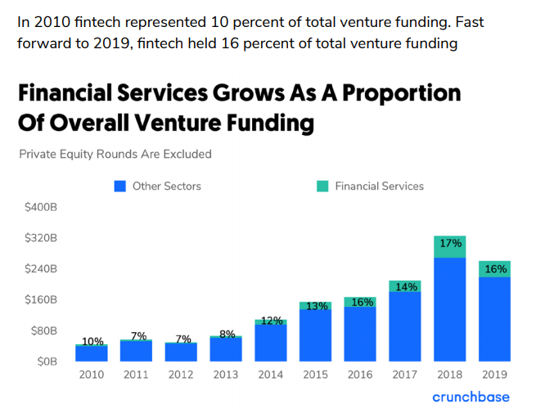
Fintech investments & IPO
One decade of venture investments in Financial Services
Investments in fintech companies have grown more than ninefold since 2010 and more than doubled since 2015.
FinTech Unicorns – there are currently over 100 unicorn companies (startup companies with a valuation of over $1billion!)
Flywire and AvidXchange IPOs expected in 2021
Although Ant Group’s $30 billion IPO failed to make a splash, Lufax just went public on Oct 30th raising $2.3 billion
For the six months ended June 30, Lufax had a net profit of more than $1 billion on total income of $3.64 billion, according to its filing.

Slide 10
Role of third parties in Fintech
Fintech third parties can help you jumpstart your Fintech journey
Implement APIs from Fintech vendors such as Plaid, Stripe, Square and PayPal
Use of Baas (Banking as a Service) to allow non-banks to embed banking services within their apps. Railsbank is part of the growing fintech trend of B2B firms offering ‘embedded finance’ to financial and non-financial firms alike
Use of RPA for process automation. UiPath is not a Fintech but it can surely help you become nimble
Fintech Middleware & BaaS (Banking as a Service)
Plaid: Some mainstream players Plaid helps power include Varo in online banking, Venmo in payments, Robinhood for investments, Credit Karma for tax filing, Affirm in lending, and Personal Capital in budgeting apps.
Adyen: A single payments platform to accept payments anywhere, on any device. Adyen allows you to be PSD2 ready
Role of Blockchain & AI
Use of Blockchain / Distributed Ledger technologies such as Hyperledger/Corda as middleware for financial contracts
PayPal joins the Bitcoin team. That means, millions of existing PayPal users (and by extension Venmo users) can start using Crypto for funds. Read the full story here.
Journey of blockchain from Bitcoin to Big Business – an excellent primer by Forbes reporter Michael del Castillo
Barclays Card Germany joins forces with Amazon to offer financing for purchases made through Amazon.de above EUR 100 (the kicker here is that credit approval is based on Amazon run AI engines churning customer data)
Non-Fintech to Now-Fintech
Facebook Libra
JPM Coin
Microsoft Excel (Yes – the oldest Fintech utility getting a reboot) will use Plaid to connect Excel to your bank account!

Slide 11
Role of data in FinTech
Shaping understanding of customer data to improve product development:
It’s the data stupid!
Companies need customer’s activity data for predictive analysis. Consider this example by Charles Duhigg where Target figured out that a teenager was pregnant before her parents did.
Open banking initiatives such as PSD2 can be a double-edged sword – making things easier for customers but at the same time allowing companies to mine customer data (yes with their permission – but then again, Facebook also permissioned Cambridge Analytica to mine user data)
Typical CRM companies such as Salesforce are integrating AI & ML deep into their product lines
Companies like Plaid of San Francisco are providing core data services to other Fintech providers like Venmo, PayPal, TD Ameritrade, Robinhood etc.
According to Fintech Magazine, personalization is critical to banking success (as seen in example of Venmo). Furthermore, Big Data will play a very big part in the new Fintech revolution as troves of data from multiple channels including IoT devices flows into via automated APIs.
Bottomline: Fintechs need massive data analysis to succeed but still need win the trust of consumers/regulators. There is an urgent need to protect customer’s interest.

Slide 12
Fintech innovation labs
Many established institutions are now setting up innovation labs to speed up Fintech innovation. The primary ones that you can consider joining to expedite your Fintech journey are listed below:
ING: Katana Labs – London, UK
AXA Next – California, USA
FinoLab – Tokyo, Japan
Citigroup: Global Innovation Labs
Legal & General
Barclays: Eagle Labs
Visa London Innovation Centre
Deutsche Bank Innovation Labs
Mastercard Labs
Accenture FinTech Innovation Lab

Slide 13
Fintech Trends for 2021
Fintech has been on the rise for last few years, but the pandemic has created a renewed urgency. If I can only focus on the topic 3, it would be the underlined:
Rise of API Driven & Embedded Finance
Bigger Focus On Cybersecurity and Regulations
Symbiotic partnerships between Traditional Financial Institutions and Fintechs
Fintech in Insurance Industry (including use of AI)
Enhanced Digitization Of Operations
Robotic Process Automation
Growing Variety Of Mobile Payment Options & Merger of some
Increased Focus On Cost Savings (to, in turn, allow for cost-based competition)
Capturing Real-Time Data For Underwriting
Reliance On Behavioral Science Tech

Slide 14
Things to follow
Some blogs and Podcasts that I found to be worth spending a few hours a week:
Reading & Newsletters
The Future of Finance: https://www.bloomberg.com/future-of-finance
Wharton Fintech on Medium: https://medium.com/wharton-fintech/
This Week in Fintech: https://thisweekinfintech.substack.com/
Forbes – 6 Fintech Writers: https://www.forbes.com/sites/nikmilanovic/2020/09/21/great-fintech-writers/?sh=3310e0b9682d
Forbes – 8 Newsletters you should be reading: https://www.forbes.com/sites/ronshevlin/2020/08/26/7-new-fintech-newsletters-you-should-be-reading/?sh=1cf47c724577
Podcasts & Webcasts
Breaking the Bank: https://provoke.fm/show/breaking-banks/
Wharton FinTech Podcast: https://www.whartonfintech.org/podcast-page
Rise Fintech by Barclays: https://rise.barclays/rise-fintech-podcast/rise-fintech-podcast/
Fintech Magazine: https://www.fintechmagazine.com/venture-capital/listen-now-fintech-podcast-carey-kolaja
Fintech Futures: https://www.fintechfutures.com/content-hub/what-the-fintech-podcast/
Fintech Insider Podcast by 11:FS: https://open.spotify.com/show/1rlLsh2Ekm1fOQJWvp0uIi

Slide 15
Reference shelf
Basic Strategies of Competition
https://www.ifm.eng.cam.ac.uk/research/dstools/porters-generic-competitive-strategies/
https://hbr.org/1979/03/how-competitive-forces-shape-strategy
History of Fintech
https://www.nytimes.com/2016/04/07/business/dealbook/the-evolution-of-fintech.html
https://www.getsmarter.com/blog/market-trends/the-history-of-fintech/
https://www.e-zigurat.com/innovation-school/blog/evolution-of-fintech/
https://www.forbes.com/sites/michaeltae/2020/11/30/lessons-from-the-fintech-revolutions-of-the-past-and-winning-post-covid/?sh=49335d2c3090
Fintech As Competitive Advantage
https://www.forbes.com/sites/esade/2019/07/30/the-fintech-revolution-who-are-the-new-competitors-in-banking/?sh=6bf381831161
https://www2.deloitte.com/us/en/pages/regulatory/articles/fintech-banks.html
https://www.bloomberg.com/quicktake/financial-technology-companies-disrupt-comfy-banks-quicktake
https://www.forbes.com/sites/ronshevlin/2020/10/12/5-bank-and-fintech-partnership-ideas-to-generate-revenue/?sh=648bf95b6e4c
Fintech Growth
https://www.forbes.com/sites/cherylwinokurmunk/2020/08/20/insurance-getting-a-fintech-facelift/
https://builtin.com/fintech/fintech-payments-companies-examples
https://www.forbes.com/sites/forbescommunicationscouncil/2020/09/23/what-banks-can-learn-from-how-fintech-firms-handled-the-paycheck-protection-program/
https://www.forbes.com/sites/nikmilanovic/2020/08/04/now-that-the-fintechs-can-be-banks-what-happens-next/
Payment Systems & Open Banking
https://www.mckinsey.com/industries/financial-services/our-insights/banking-matters/building-a-successful-payments-system
https://www2.deloitte.com/global/en/insights/industry/financial-services/open-banking-model-strategy-united-states.html

Slide 16
Questions?
Please remember! This was an information sharing session – not a lecture on Fintech
This presentation will stay as work in progress for near future as a result of rapid changes in the Fintech markets
Updated versions will be made available on Medium and GitHub
Connect with me
https://www.linkedin.com/in/sandyaggarwal/
Thank you!

